Slide 1
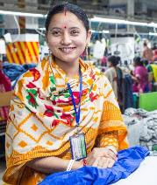
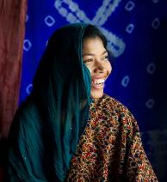
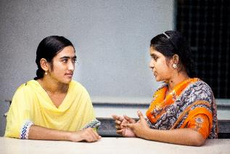
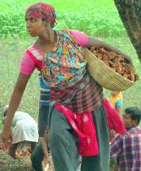
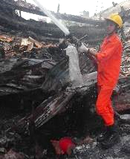

Shanchita-Financial Literacy App
Power of knowledge in every hand

Slide 2
Paradox of Financial Inclusion
90%
MFI users are women
35%
Women bank account holders
*Higher than South Asia Regional Average
21m clients
Micro-Finance Institutions (MFI)
Formal Banking
20%
Women have full control over their loan
44%
Women transfer income minus minor personal expenses
63%
Purchased asset in others’ name
15% equal control with spouse
No personal assets = Ineligible for bank loans
65% little or no control
ACCESS to finance does not mean OWNERSHIP or CONTROL of financial and other assets
25%-30% interest rates make MFI loans too expensive

Slide 3
Core Issue: Financial Literacy & Social Acceptance
2.8m
Women in RMG
52% Financial service = Only transferring money
35% Financial service = No Idea
Social Barrier
46% Spouse does not approve personal bank
49% Spouse does not approve mobile banking
16m
Formal Bank Accounts
21,500
“Access to finance” is only income/loan transfer for many women
Financial Literacy is essential to turn financial access into actual control over own income
RMG Workers’ account
Micro-Finance Institutions (MFI)

Slide 4
VISA Project: Economic Empowerment & Financial Literacy
~1000 Female RMG workers trained
6000+ community people reached
200 new bank accounts
Own Bank accounts: 22% to 95%
Frequency: Last used 1.2 months ago from 4 months
Savings: From 62% to 94%
Joint Control over earnings reached 94% from 65% having little or no control
Annual Savings Goal: Increased from Tk. 22,000 to Tk. 56,000 (2.5 times)
Annual Savings: Tk. 35,304 (41% higher than initial)
Financial Behavior
Social Behavior
Spousal opposition to bank account: Fell from 46% to 5%
Investment source shifting from loans to savings
87% sent remittance back home – shifting to shared business ventures
ATM booths at factories
New branches opened near targeted 5 factories

Slide 5
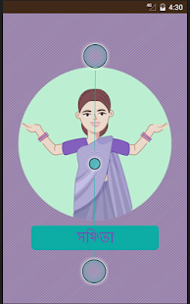
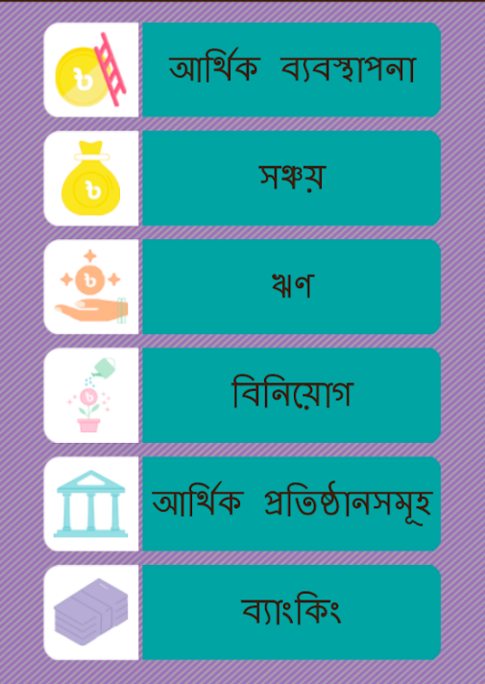
Scaling Plan: Uptake of Financial Literacy App
Android application developed with basic financial literacy module for one-time download
Why Android?
Bangladesh – Among largest user base globally: 140m mobile users, 80m using internet
Smartphone penetration growing at 57.44% annually (1.5 times)
Bangladesh accounts for 8% of total mobile bank accounts globally
Smartphone usage to reach 60% by 2020 - fastest, cheapest way to reach mass population with targeted messaging
Financial management
Uptake Increase Strategy:
In-built app in local branded smartphone
Sold in Gazipur Area for women
Social media marketing
4 other projects working
Bangla 7th most common language
Savings
Loans
Investment
Financial Institutions
Banking

Slide 6
Thank you
https://play.google.com/store/apps/details?id=care.financial.literacy

